Slide 1
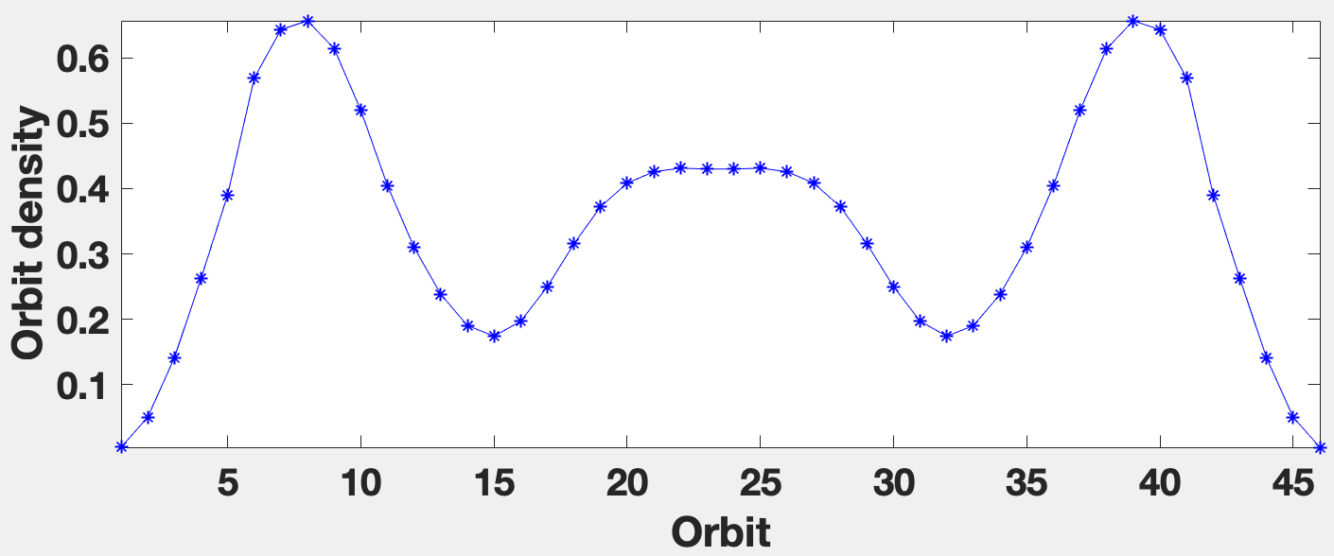
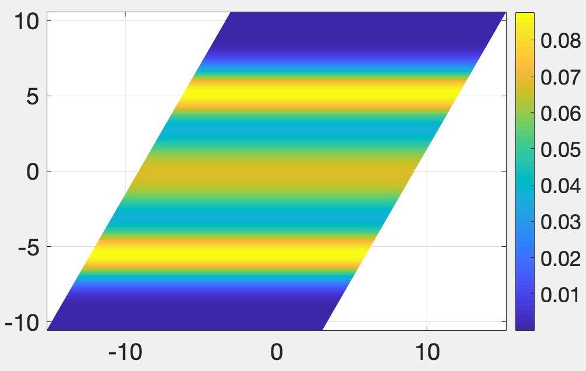
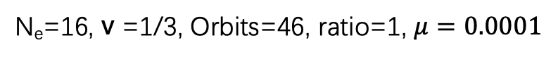
N_{e}=16, v =1/3, Orbits=46, ratio=1, $μ=0.0001$
parallelogram
Pair correlation function
Electron density

Slide 2
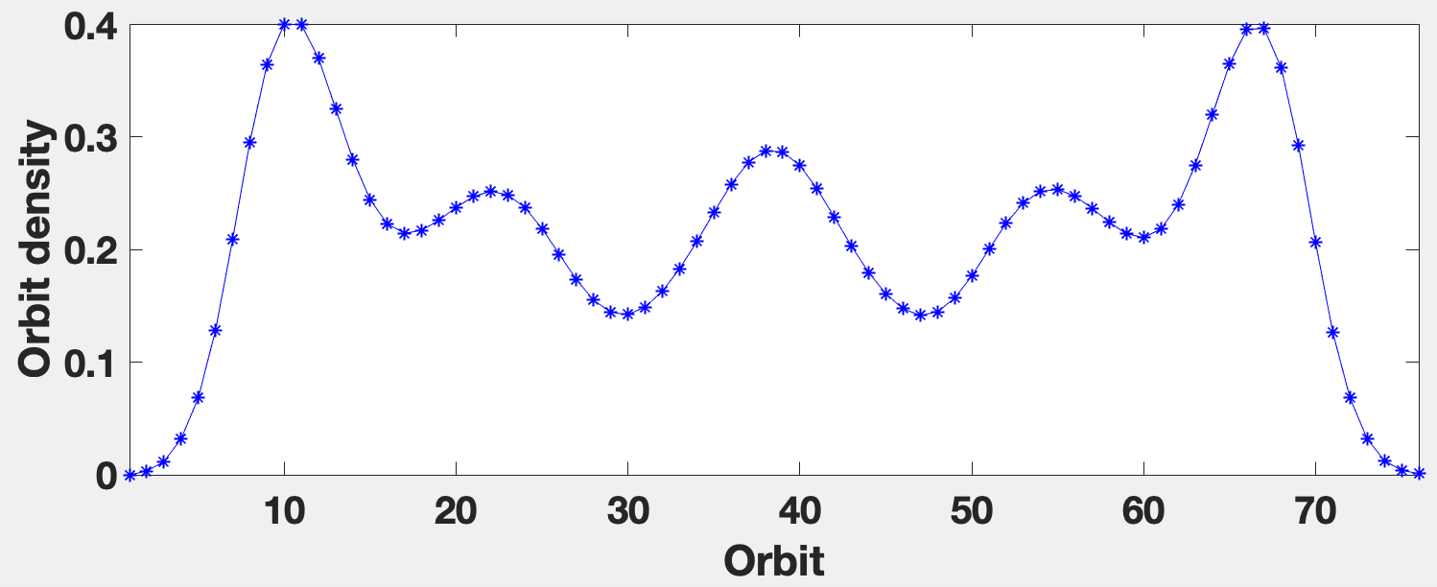
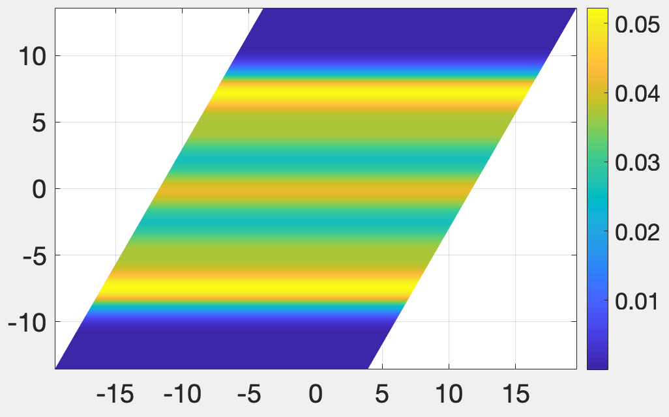
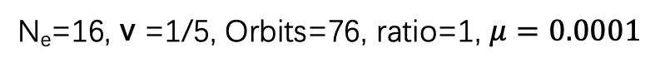
N_{e}=16, v =1/5, Orbits=76, ratio=1, $μ=0.0001$
parallelogram
Pair correlation function
Electron density

Slide 3
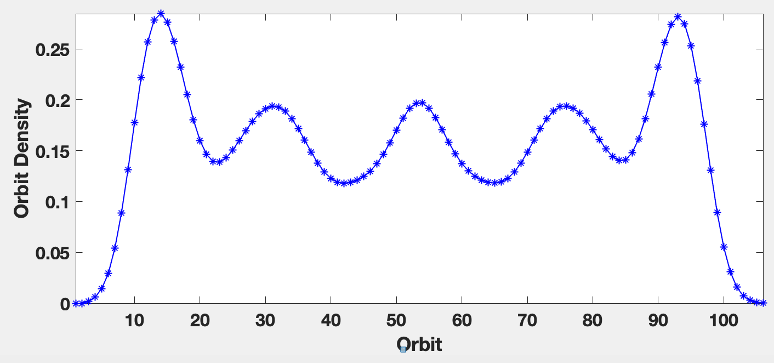
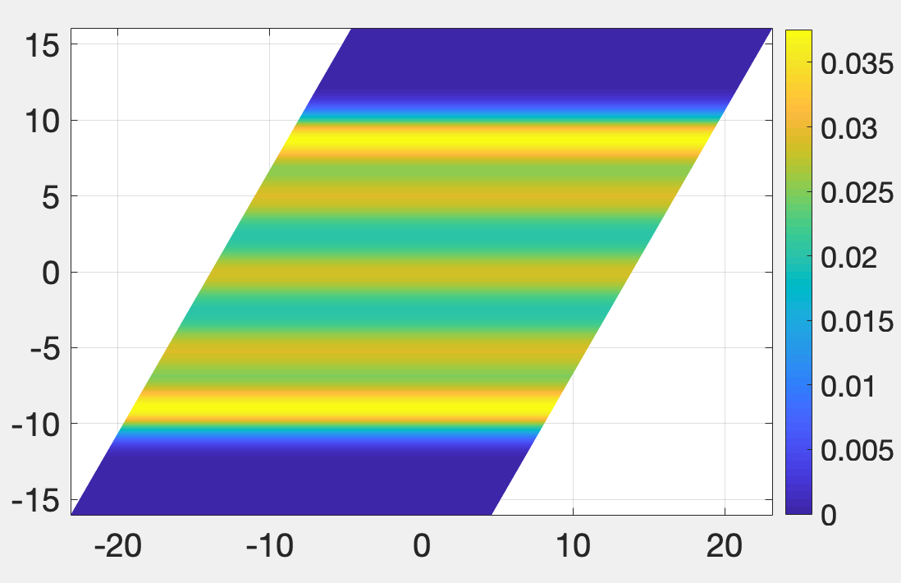

N_{e}=16, v =1/7, Orbits=106, ratio=1, $μ=0.0001$
parallelogram
Pair correlation function
Electron density

Slide 4
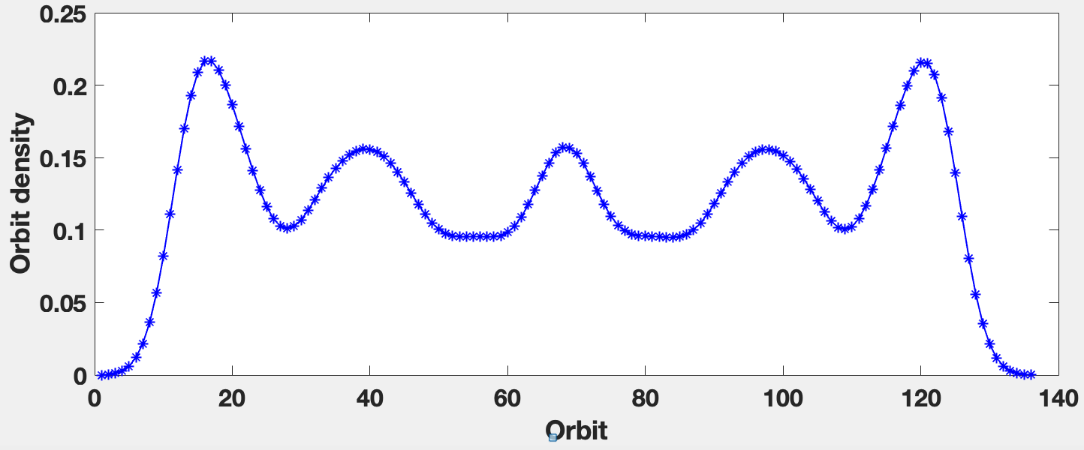
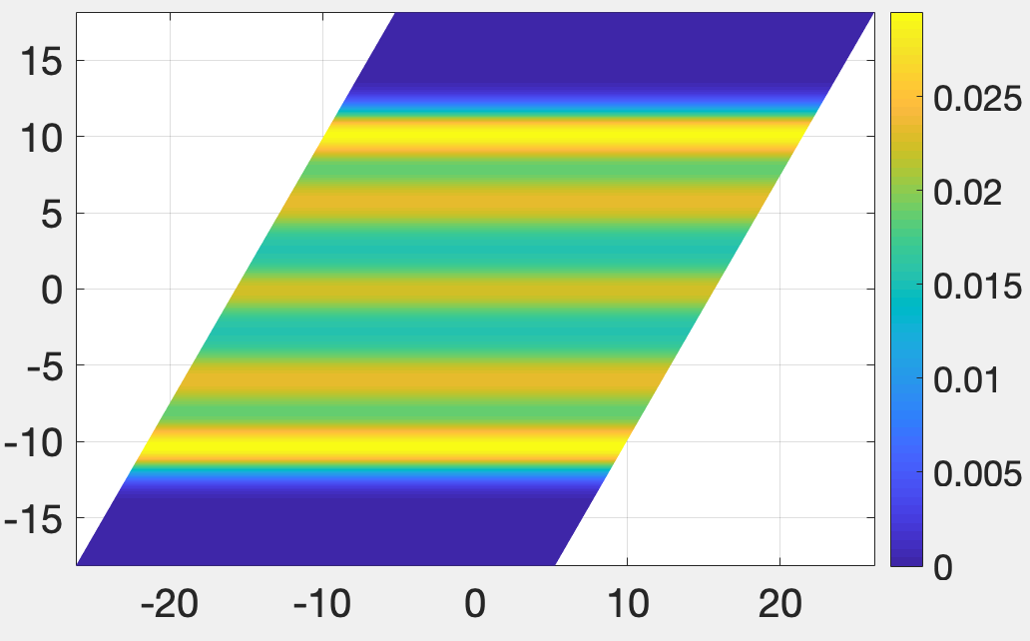

N_{e}=16, v =1/7, Orbits=136, ratio=1, $μ=0.0001$
parallelogram
Pair correlation function
Electron density

